Slide 1
Chemical Reaction Engineering – II (CL24303)
MO2026

Slide 2
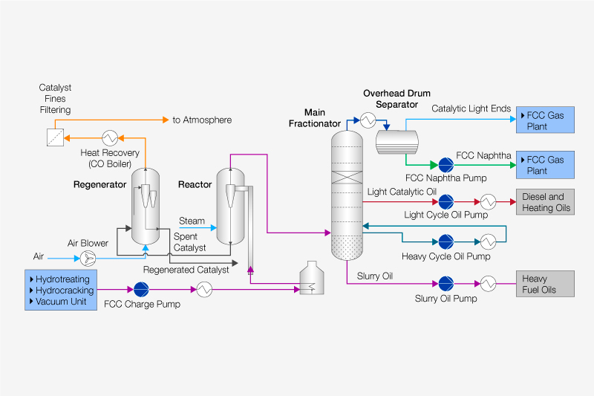
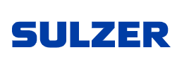
Fluidized Catalytic Cracking (FCC)
Fluidized Bed
Parameter | Typical Value
Reactor temp | 490–550 °C
Regenerator temp | 650–750 °C
Pressure | 1.5–3 atm
Catalyst/oil ratio | 5.5 (wt/wt)
Residence time | 2–5 seconds
Catalyst- Y-Zeolites

Slide 3
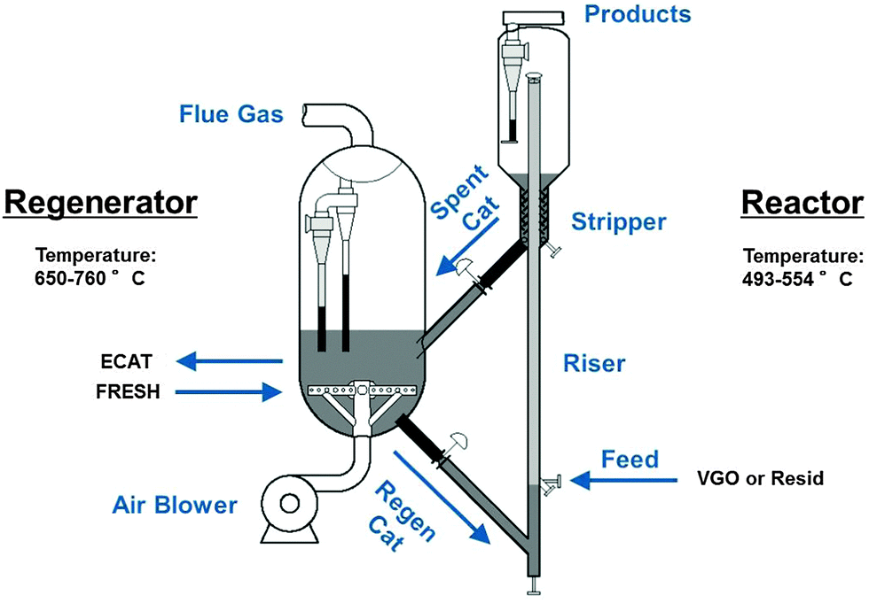
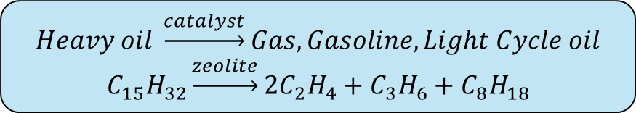
Fluidized Catalytic Cracking (FCC)
$$Heavy oil \underset{→}{catalyst}Gas, Gasoline, Light Cycle oil$$
$$C_{15}H_{32}\underset{→}{zeolite}2C_{2}H_{4}+C_{3}H_{6}+C_{8}H_{18}$$
Pressure balance
Thermal Balance
Fluidized Bed
Parameter | Typical Value
Reactor temp | 480–550 °C
Regenerator temp | 650–715 °C
Pressure | 1.5–3 atm
Catalyst/oil ratio | 5.5 (wt/wt)
Residence time | 2–5 seconds
Catalyst- Y-Zeolites (Faujasite)
Size- 50-100 μm
Vogt, E.T. and Weckhuysen, B.M., 2015. Chemical Society Reviews, 44(20), 7342-7370

Slide 4

Steps in Catalytic Reaction
2. Diffusion of ‘A’ to active site from pore mouth
3. Adsorption of A
4. Surface reaction of A to B
5. Desorption of B
1. Transport of ‘A’ to pore mouth from bulk
B
A
A
A
B
6. Diffusion of ‘B’ from active site to pore mouth
B
Catalyst Pore
7. Transport of ‘B’ from pore mouth to bulk
Active Sites
Catalyst Particle

Slide 5

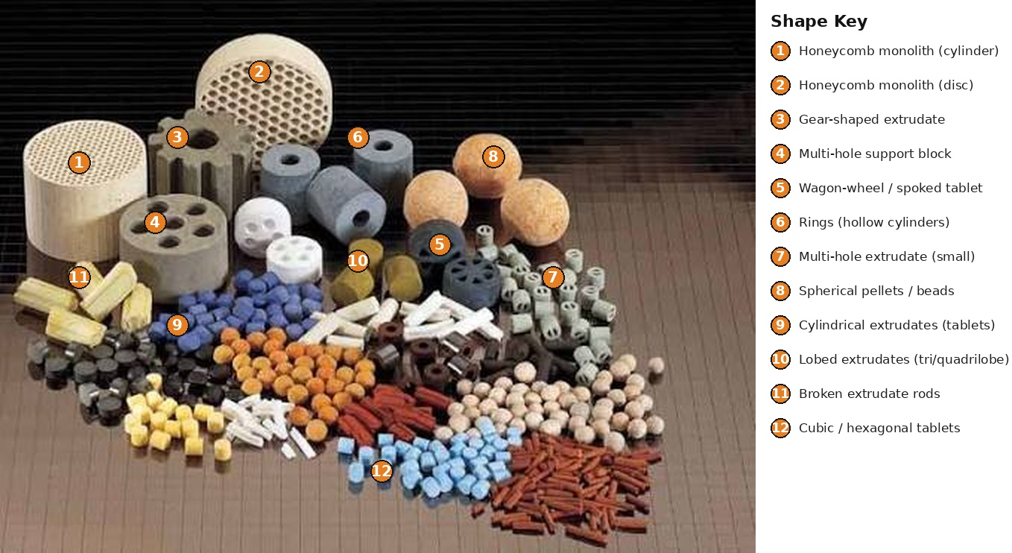
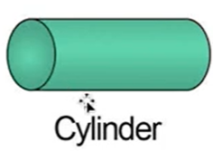
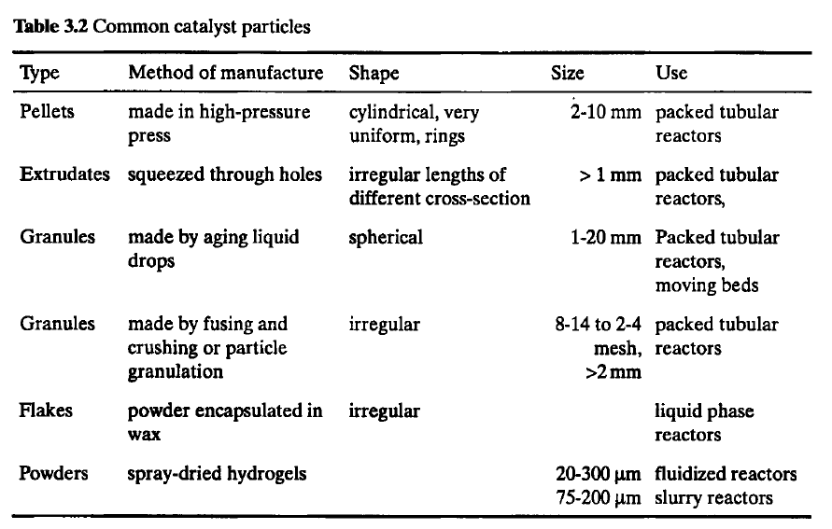
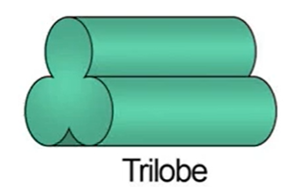
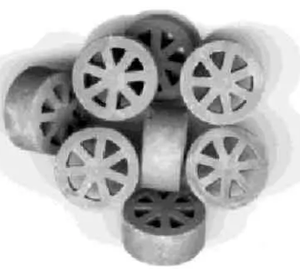
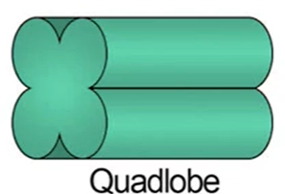
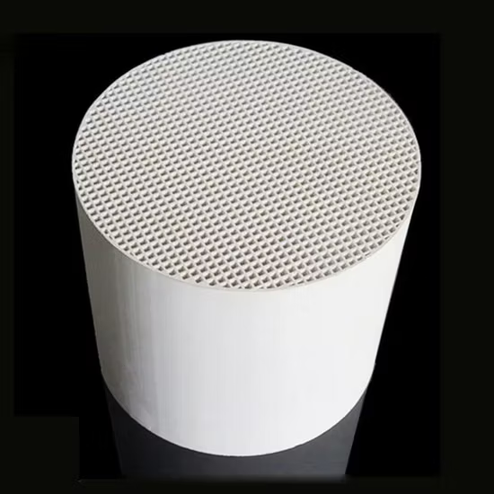
Catalyst Shapes
Wagon wheel
Monolith

Slide 6
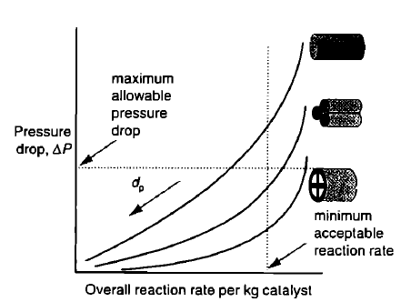
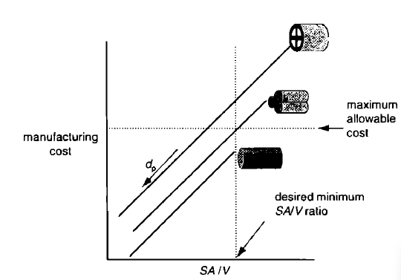
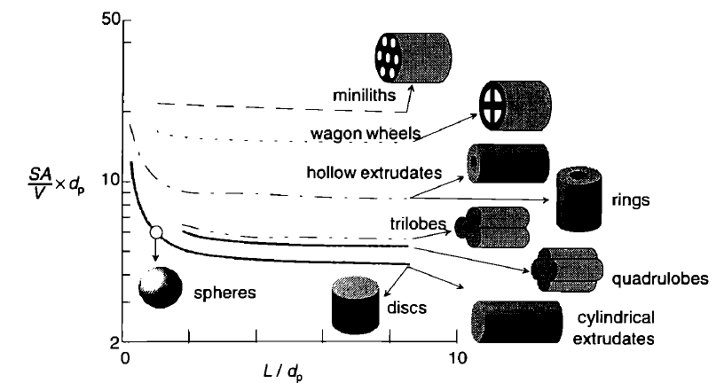
Effects of Catalyst Shapes

Slide 7
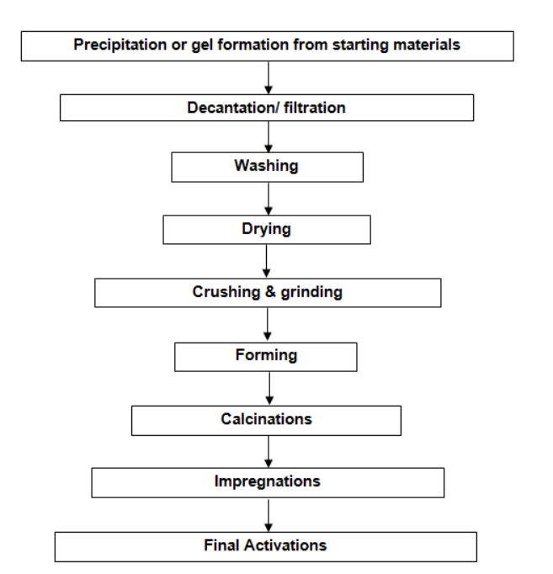

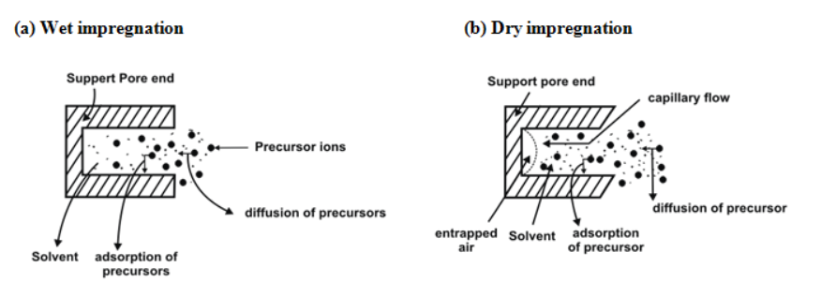
Catalyst Preparation

Slide 8
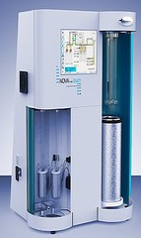
BET Measurement
Carrier Gas
N₂ + He
Adsorbate
Test Station
Sample Degassing

Slide 9
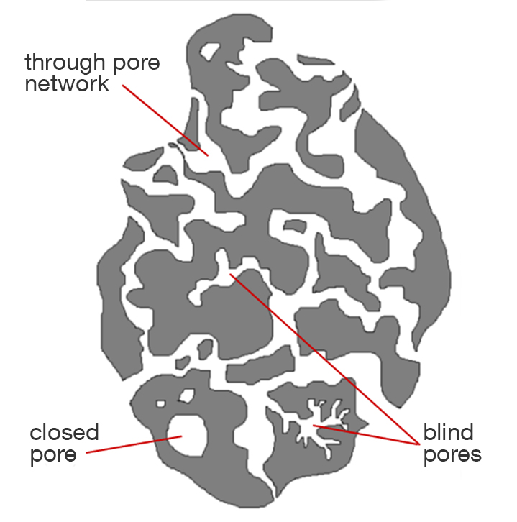
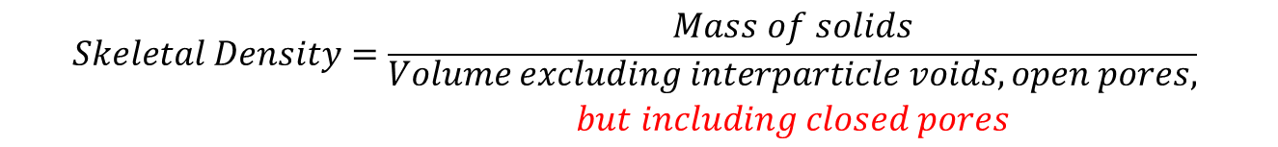
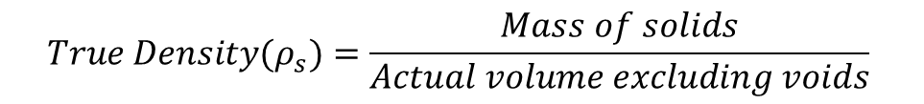
Density
$$True Density(ρ_{s})=\frac{Mass of solids}{Actual volume excluding voids}$$
A+B
$$Skeletal Density=\frac{Mass of solids}{\begin{aligned}Volume excluding interparticle voids, open pores, \\ but including closed pores\end{aligned}}$$
Interparticle Void
Intraparticle Void
$$Bulk Density=\frac{Mass of solids}{Loosely packed volume}$$
$$Transverse Axial Pressure (TAP) Density=\frac{Mass of solids}{Densely packed volume}$$
C
$$Pellet Density(ρ_{p})=\frac{Mass of pellet}{Volume of pellet}$$
$$Pellet Porosity(ε_{p})=\frac{Void volume of pellet}{Total volume of pellet}$$

Slide 10
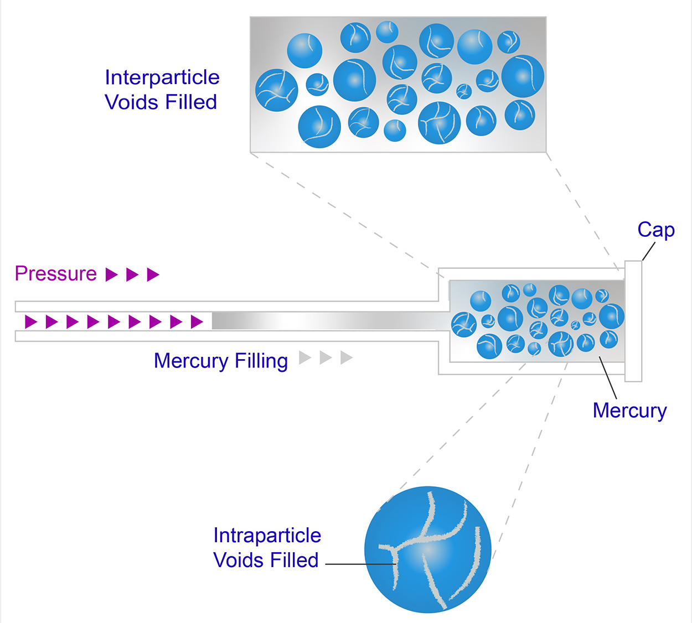
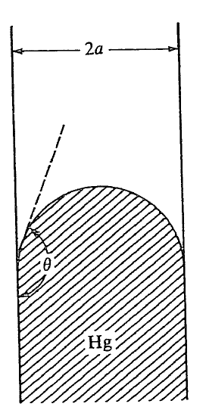
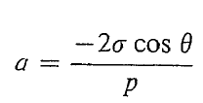
Pore Volume – Mercury Intrusion Method
Ritter and Drake

